Slide 1

COMP4432 Project
A Million News Headline
LIU Yuzhou 21100602D
YUAN Yunchen 21100038D
LU Zhoudao​ 21099695D​
Notes:
Hi, let us show the achievements for our projects

Slide 2
Data Understanding and Preprocessing
1
2
Topic Modelling
CONTENTS
3
Classification
4
Sentiment analysis
And stock price prediction
Notes:
This is our content

Slide 3
Data Understanding and Preprocessing
PART 1
Notes:
The first part is data understanding and preprocessing

Slide 4
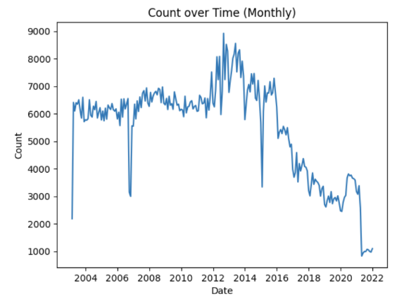
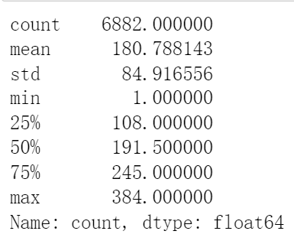
Data Understanding
2003-02-19 to 2021-12-31
1, 244, 184 headlines in total
Table 1: Number of data statistics
Figure 1: Number of data statistic
Notes:
Now we have a dataset. there are one million two hundred forty-four thousand one hundred and eighty-four headlines in total. The quantity based on days /months is presented in table 1 and Figure 1.

Slide 5

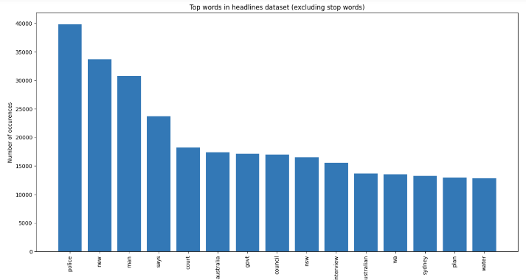
Data Understanding
8, 158, 765 words
118, 046 of them are unique
Figure 2: Wordcloud for words Figure 3: word count
Notes:
We have counted the number of total words and unique words. We also show the wordcloud count for the most common words.

Slide 6
Data Preprocessing
Tokenization
dividing text into discrete units called tokens
Eg: remove stop words: a, not …
Stemming
text normalization technique in natural language processing that aims to reduce words to their base or root form
Eg: ‘manager’, ‘management’ and ‘managing’ can be considered as one word
Lemmatization
takes into account the morphological analysis of words and applies linguistic rules to determine the lemma
Eg: "cats" is lemmatized to "cat," "running" to "run," and "playing" to "play."
Notes:
There are three data preprocessing methods, tokenization, stemming and lemmatization. Tokenization can be used to divide text and remote stop words; stemming can reduce words to their base or root form; lemmatization applys linguistic rules to determine the lemma

Slide 7
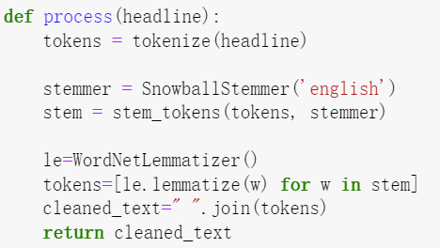
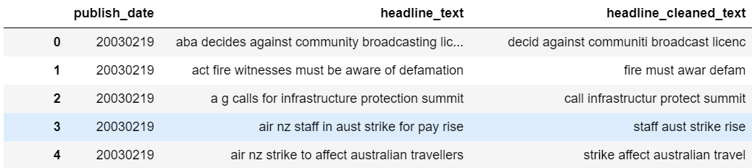
Data Preprocessing
Notes:
The preprocessing code and preprocessing results are shown.

Slide 8
Topic Modelling
PART 2

Slide 9
Topic Modeling Pipeline
Embedding method
Vector Embeddings
Dimension Reduction
Reduced
Embeddings
Text
Topic Representation
learning
Clustering
Topic Representation
Cluster
Methodology：
1, Comparative experiment: general pipeline + different settings + same metrics
2, Incremental optimization: default setting + optimize stages by stages
3, Comprehensive analysis: experimental results + visual results.
Notes:
First, I try logistic regression. Logistic regression uses a logistic function called a sigmoid function to map predictions and their probabilities. First, I try the simplest model and the result is 0.74.

Slide 10
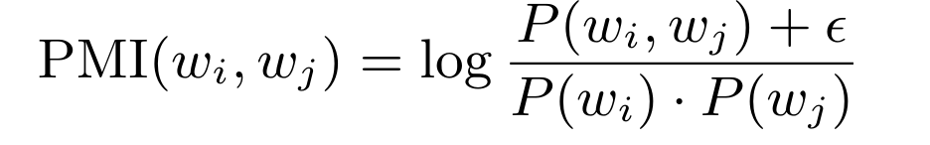
Objective & Analysis
Objective
Consistency with topic and contents
Diversity among topics
TC & TD
Topic diversity (TD): calculated based on the Normalized Pointwise Mutual Information (NPMI)
Topic coherence (TC): cv mode, ranges from [0, 1], a larger value indicates a better performance of the model.
Notes:
First, I try logistic regression. Logistic regression uses a logistic function called a sigmoid function to map predictions and their probabilities. First, I try the simplest model and the result is 0.74.

Slide 11
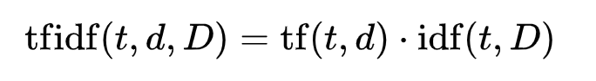
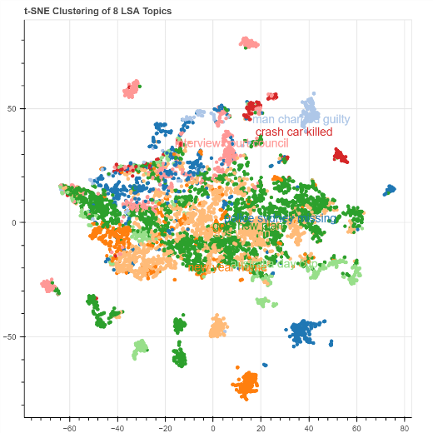
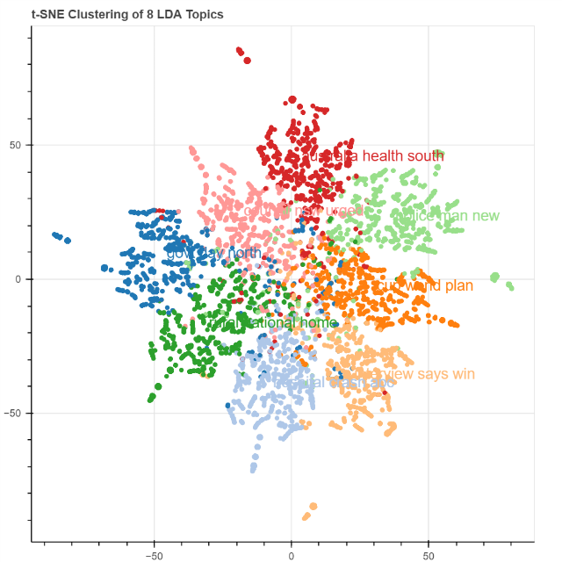
Traditional Methods
Tf-idf score
TSNE result of LSA
TSNE result of LDA
Notes:
First, I try logistic regression. Logistic regression uses a logistic function called a sigmoid function to map predictions and their probabilities. First, I try the simplest model and the result is 0.74.

Slide 12
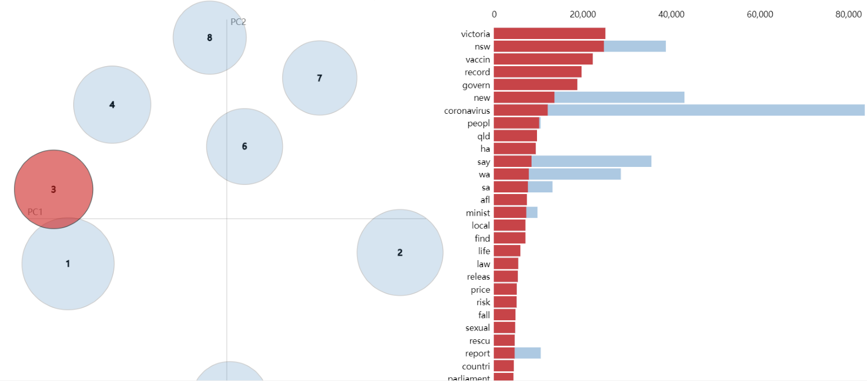
LSA(Traditional)
Topics | Top 6 words | Num headlines
1 | police sydney death missing adelaide search | 960
2 | man charged guilty sex jailed child | 1228
3 | new help year home deal indigenous | 2788
4 | says health minister sa election workers | 2137
5 | govt nsw water qld plan rural | 987
6 | australia day cup world coronavirus south | 1026
7 | crash car dies killed hospital road | 442
8 | interview council court australian report trial | 432
LSA table
Notes:
First, I try logistic regression. Logistic regression uses a logistic function called a sigmoid function to map predictions and their probabilities. First, I try the simplest model and the result is 0.74.

Slide 13
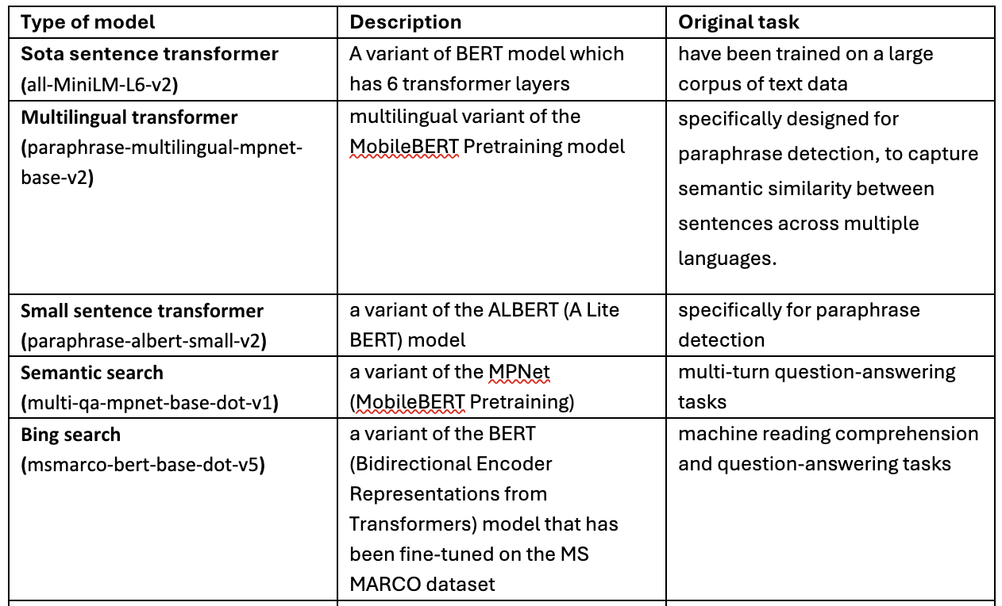
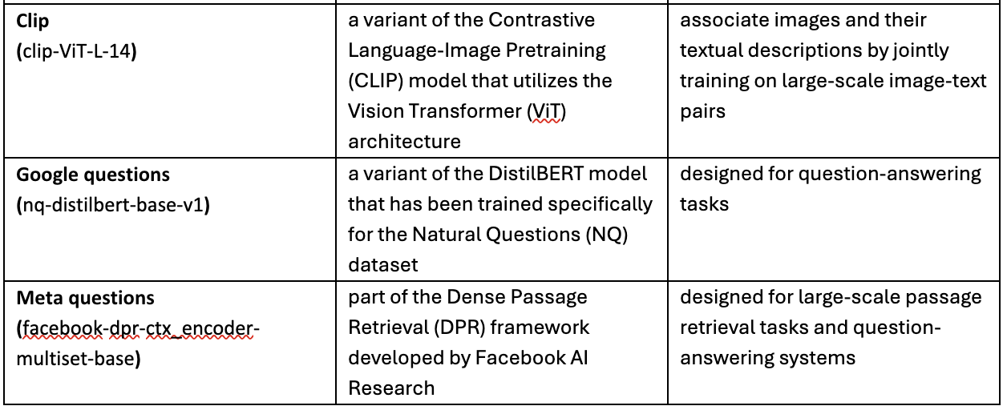
Deep Learning based Embeddings
Different text encoders trained on different task.
However,
Original Domain different with the news（content） headlin（format） embedding
Notes:
First, I try logistic regression. Logistic regression uses a logistic function called a sigmoid function to map predictions and their probabilities. First, I try the simplest model and the result is 0.74.

Slide 14
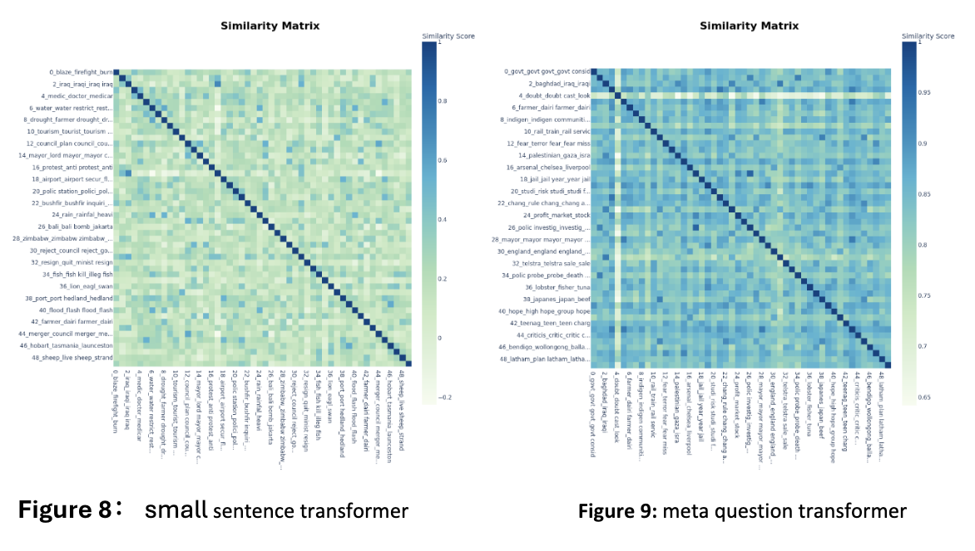
Visual analysis
Heat Map:
Distance of topic enter embeddings --> similarity between topics --> diversity of topic modeling
Notes:
First, I try logistic regression. Logistic regression uses a logistic function called a sigmoid function to map predictions and their probabilities. First, I try the simplest model and the result is 0.74.

Slide 15
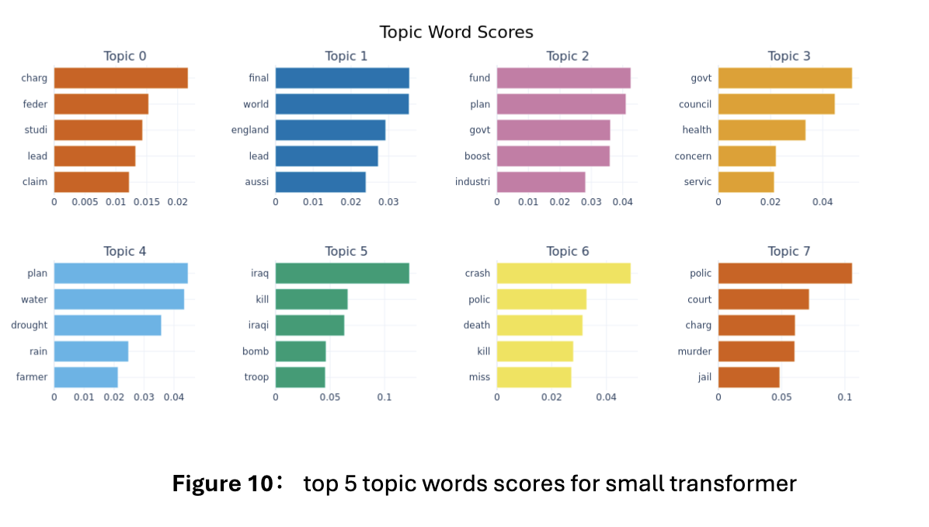
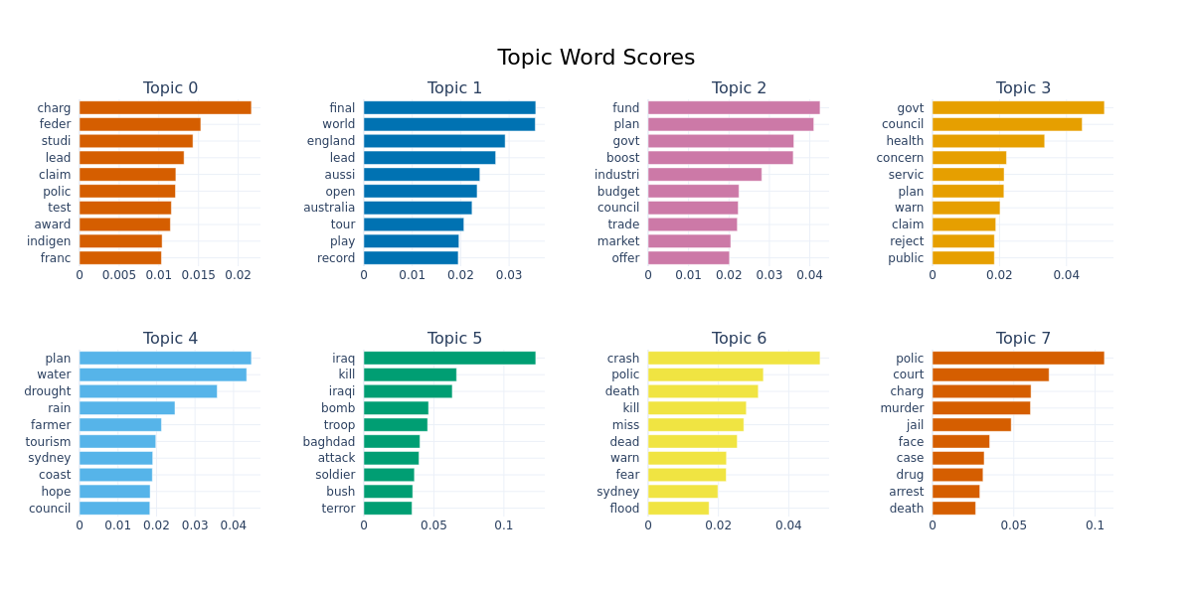
Visual analysis
Top words distribution:
Intra-comparison: topic diversities
Inter-comparison: topic consistency (sililar topics)
Notes:
First, I try logistic regression. Logistic regression uses a logistic function called a sigmoid function to map predictions and their probabilities. First, I try the simplest model and the result is 0.74.

Slide 16
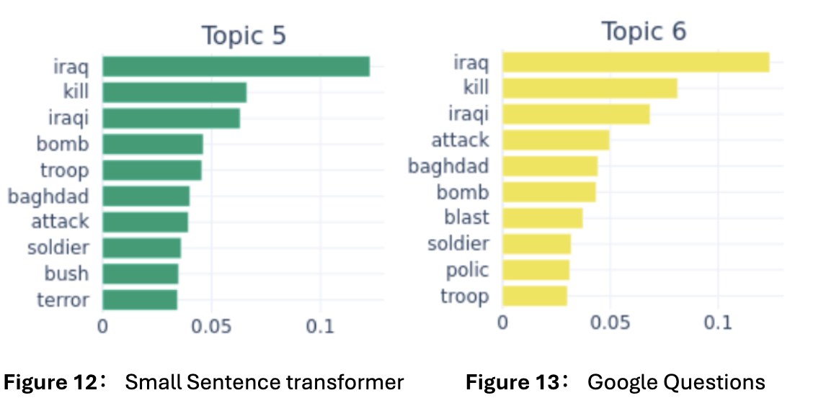
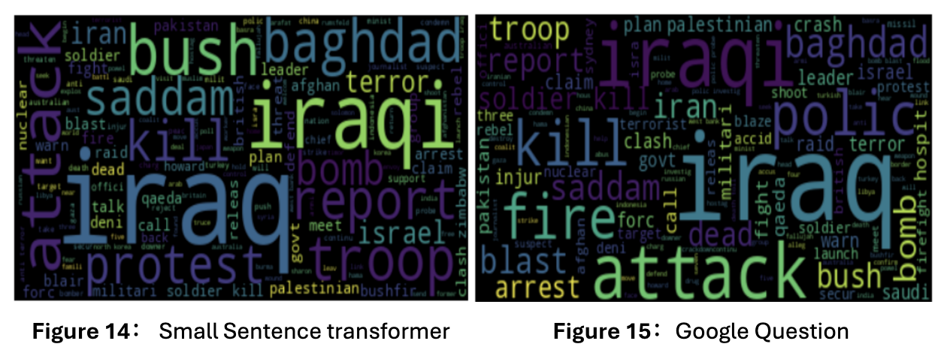
Findings
Similar topics get from different embeddings:
Coherence of topics with content
Validity of topic modeling methods
Notes:
First, I try logistic regression. Logistic regression uses a logistic function called a sigmoid function to map predictions and their probabilities. First, I try the simplest model and the result is 0.74.

Slide 17
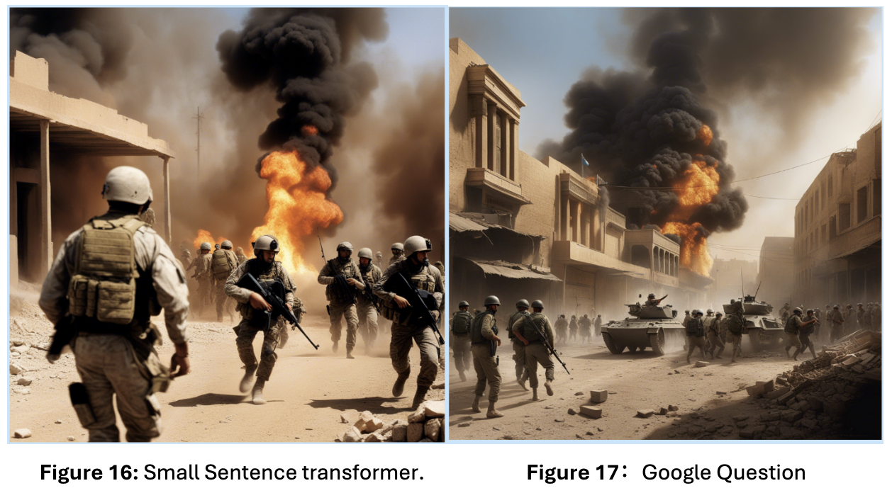
Findings
Similar topics get from different embeddings:
Further proof by the topic image:
Topic key words --> prompt generated by GPT4 --> image generated by text-to-image model
Notes:
First, I try logistic regression. Logistic regression uses a logistic function called a sigmoid function to map predictions and their probabilities. First, I try the simplest model and the result is 0.74.

Slide 18
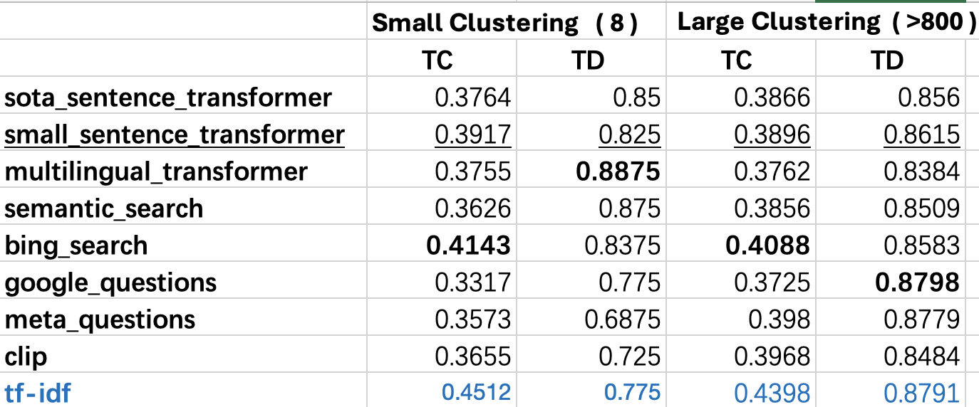
Quantitive analysis
Two default settings:
Small clusteing: LSA + 8-k-means
Large Clustering: UMAP + HDBCAN
Notes:
First, I try logistic regression. Logistic regression uses a logistic function called a sigmoid function to map predictions and their probabilities. First, I try the simplest model and the result is 0.74.

Slide 19
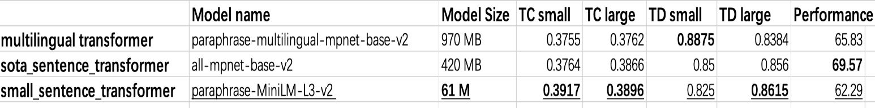
Model Selection
Small Sentence Transformers: Paraphrase-MiniLM-L3-V2
1, performance: suitable for sentence embedding, stable performance
2, efficiency: smaller than other models
3, fine-tuning: less risk of overfitting and catastrophic forgetting
Notes:
First, I try logistic regression. Logistic regression uses a logistic function called a sigmoid function to map predictions and their probabilities. First, I try the simplest model and the result is 0.74.

Slide 20
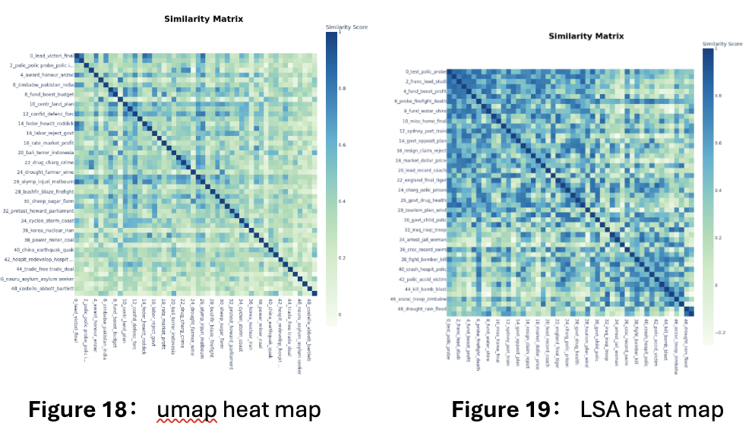
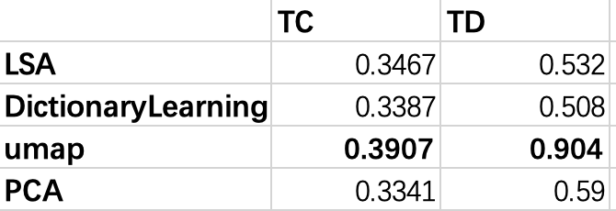
Dimension Reduction Methods
Dictionary Learning: a technique used to represent data as a sparse linear combination of basic elements from a learned dictionary.
Umap: a dimensionality reduction technique commonly used for visualizing high-dimensional data in a lower-dimensional space.
Notes:
First, I try logistic regression. Logistic regression uses a logistic function called a sigmoid function to map predictions and their probabilities. First, I try the simplest model and the result is 0.74.

Slide 21
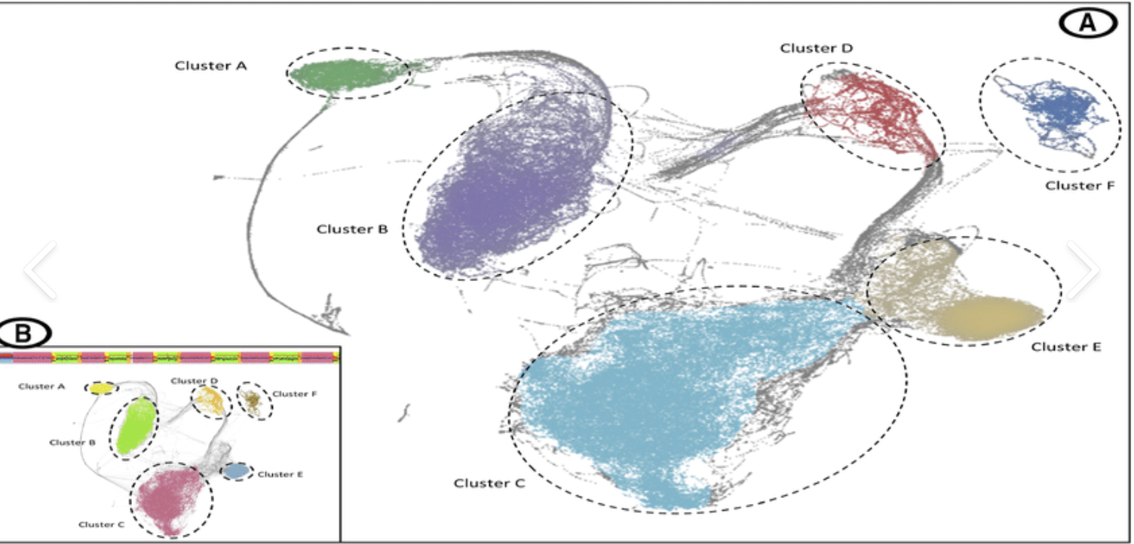
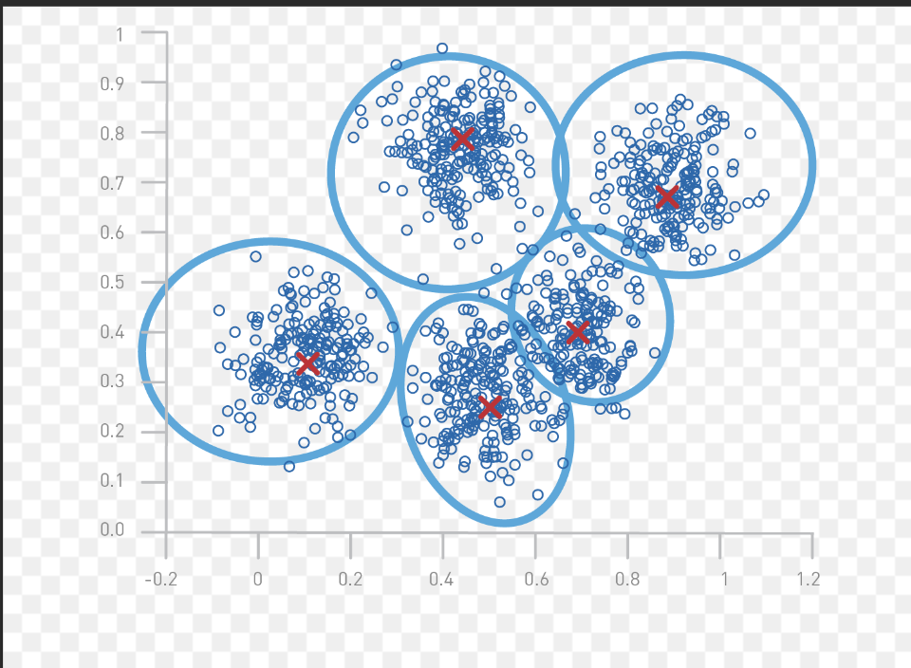
Clustering: clustering Methods
HDBSCAN (Hierarchical Density-Based Spatial Clustering of Applications with Noise) ensity-based spatial clustering algorithm that automatically discovers the structure of the clusters in a dataset and does not require a predetermined number of clusters.
HDBSCAN:
noisy data and irregular shape clustering
higher tolerance for outliers
but will exclude outlier, affecting a certain applicability.
K-means:
computational efficiency
performs quite well on regular shape of clusters.
Less tolerance for noisy data
Also, the tolerance for outliers is low.
Notes:
First, I try logistic regression. Logistic regression uses a logistic function called a sigmoid function to map predictions and their probabilities. First, I try the simplest model and the result is 0.74.

Slide 22
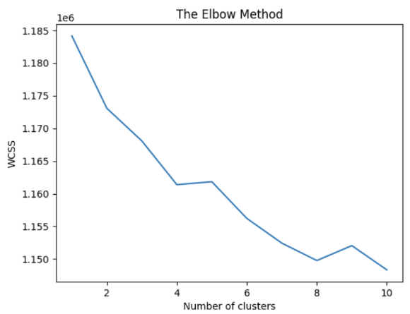
Clustering: Number of clusters
elbow method is a commonly used technique to determine the optimal number of clusters in clustering algorithms. We use the embeddings to analyze within-cluster sum of squares (WCSS).
2 Types:
Exhaustive clustering
Partial clustering
（remove outlier and small clusters）
3 Settings:
Small: 8
Mid: 50
Large: 800
Notes:
First, I try logistic regression. Logistic regression uses a logistic function called a sigmoid function to map predictions and their probabilities. First, I try the simplest model and the result is 0.74.

Slide 23
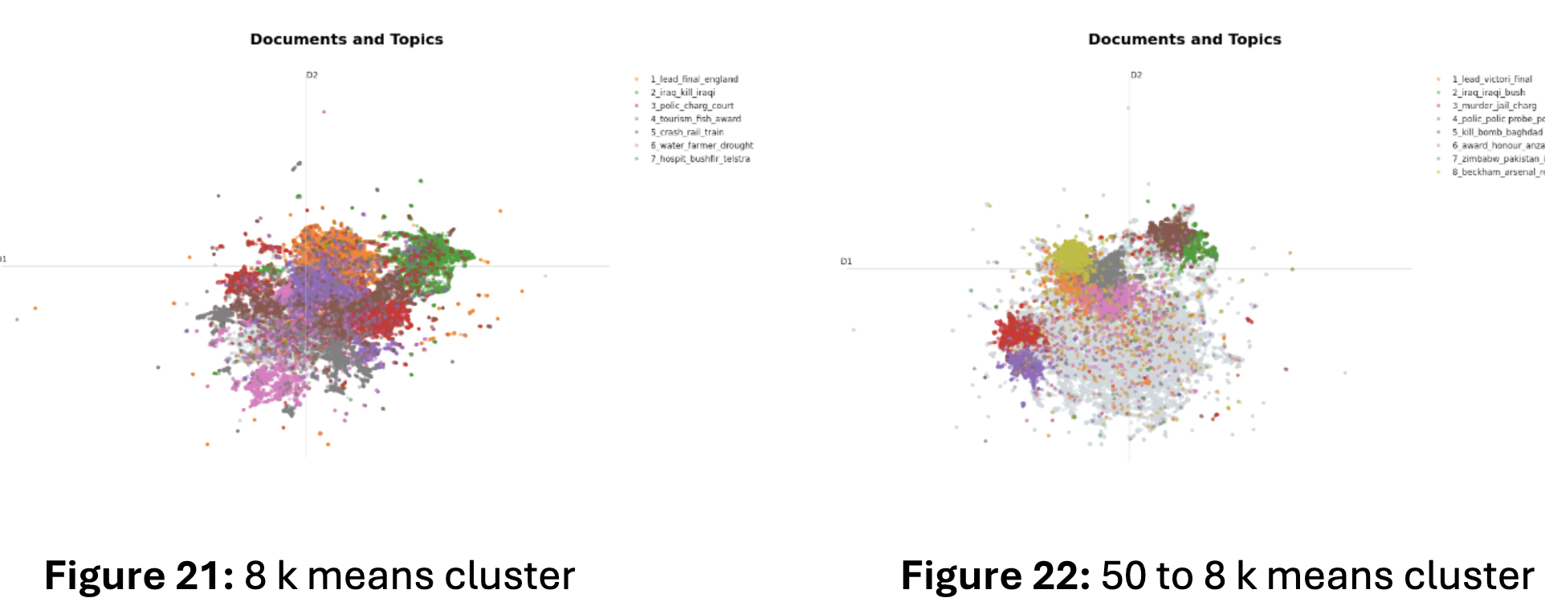
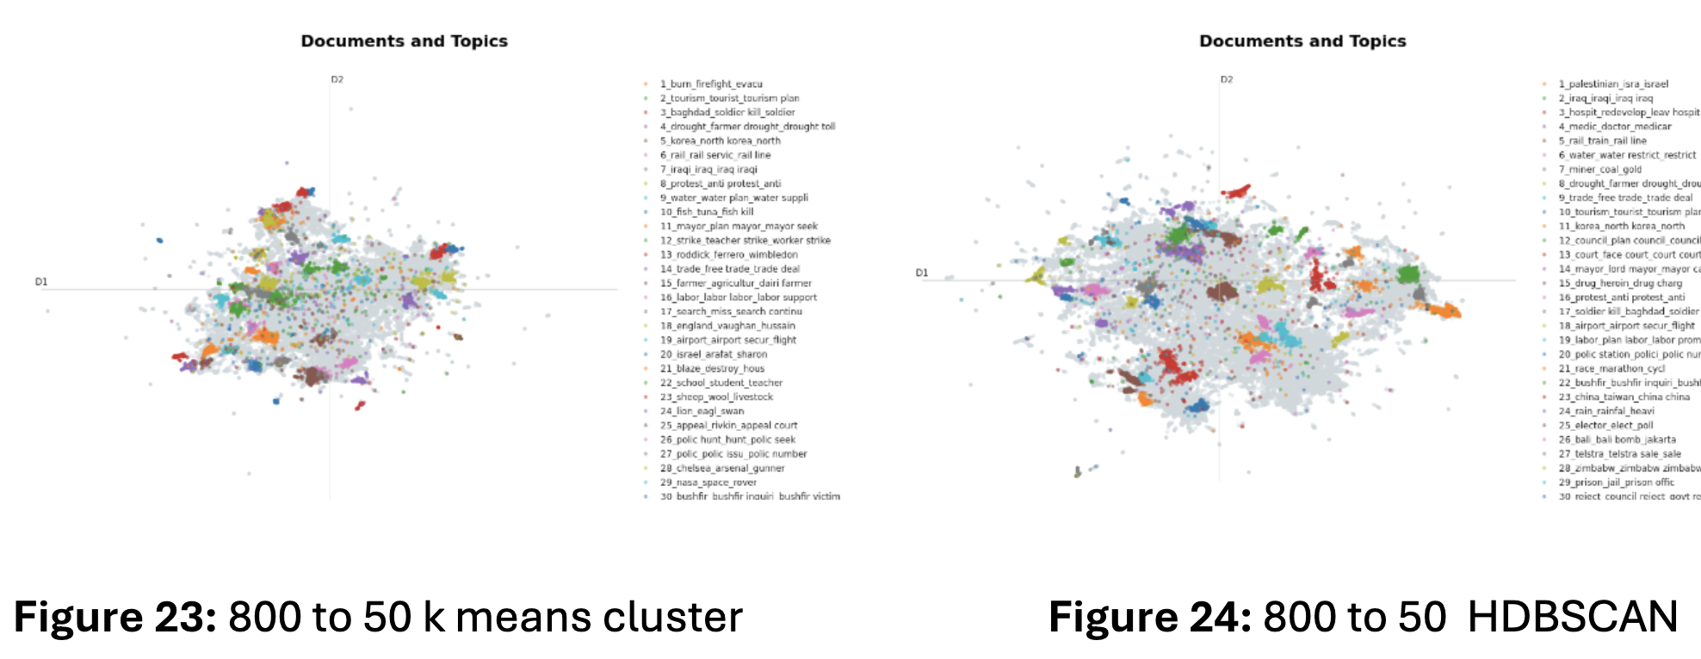
Clustering: Results
Notes:
First, I try logistic regression. Logistic regression uses a logistic function called a sigmoid function to map predictions and their probabilities. First, I try the simplest model and the result is 0.74.

Slide 24
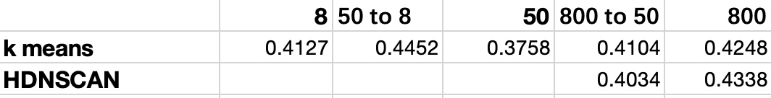
Clustering: Results
HDNSCAN shows better results than k means on large-scale clustering.
k means method has relatively stable performance at different scales.
Selection：
8: k-means clustering. 50: 800-50 k-means. 800: HDNSCAN
Notes:
First, I try logistic regression. Logistic regression uses a logistic function called a sigmoid function to map predictions and their probabilities. First, I try the simplest model and the result is 0.74.

Slide 25
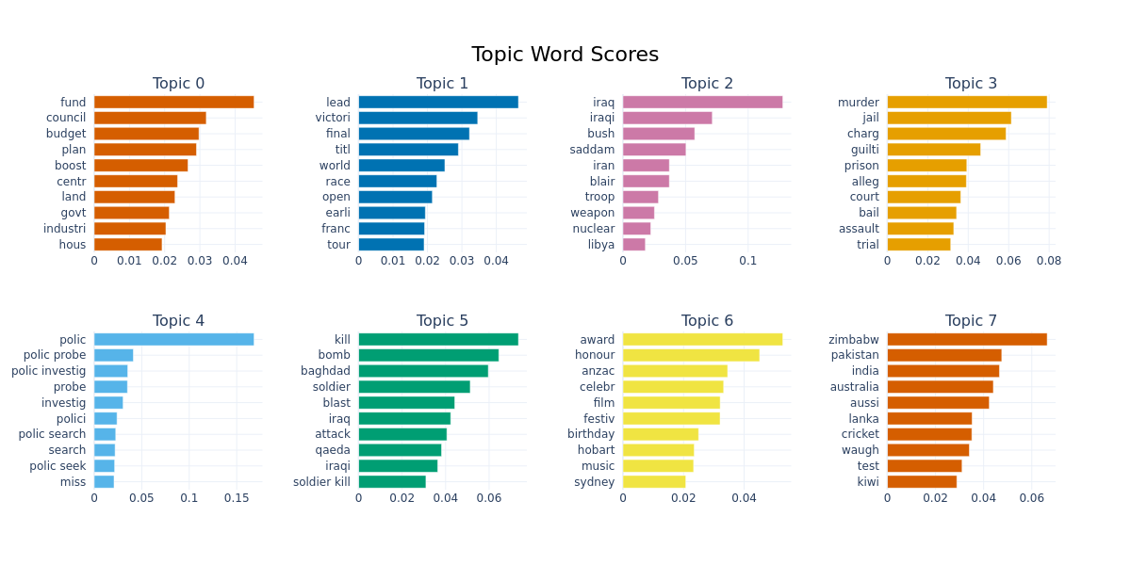
Topic Representation
Topic top terms + weight
summarized by topic modeling model KeyBART
Notes:
First, I try logistic regression. Logistic regression uses a logistic function called a sigmoid function to map predictions and their probabilities. First, I try the simplest model and the result is 0.74.

Slide 26
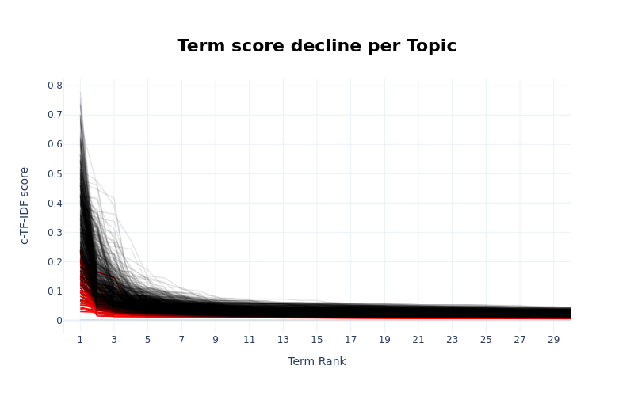
Topic Representation: number of terms
semantic scores for each topic against the rank of the word
Convergence: less importance for add words
Notes:
First, I try logistic regression. Logistic regression uses a logistic function called a sigmoid function to map predictions and their probabilities. First, I try the simplest model and the result is 0.74.

Slide 27
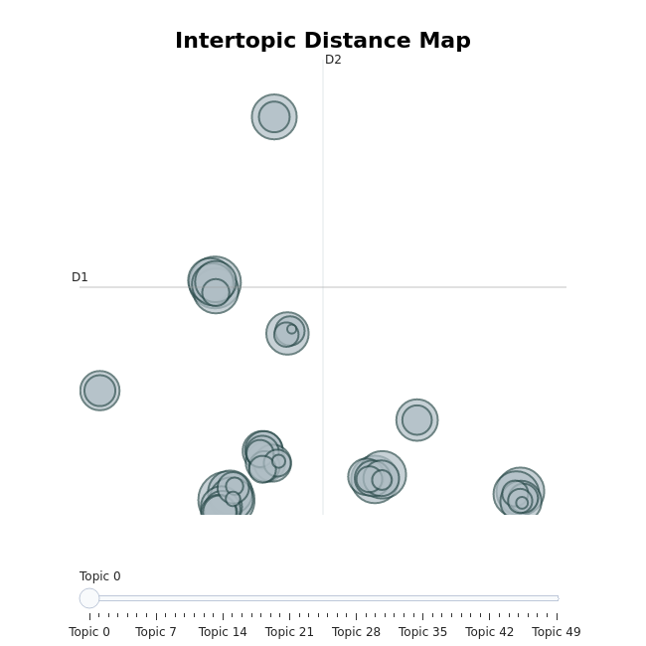
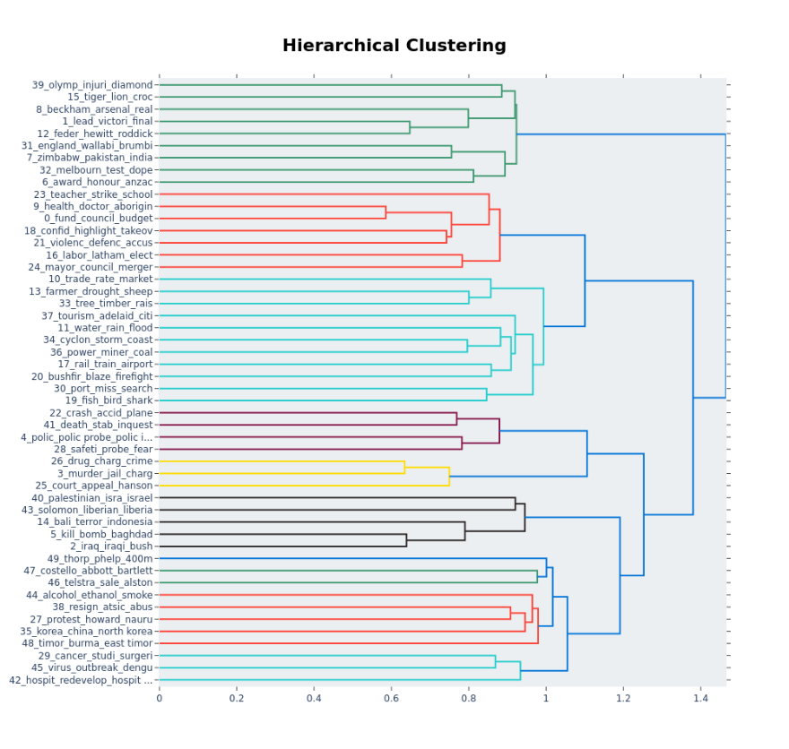
Topic Representation: relationship of topics
Notes:
First, I try logistic regression. Logistic regression uses a logistic function called a sigmoid function to map predictions and their probabilities. First, I try the simplest model and the result is 0.74.

Slide 28

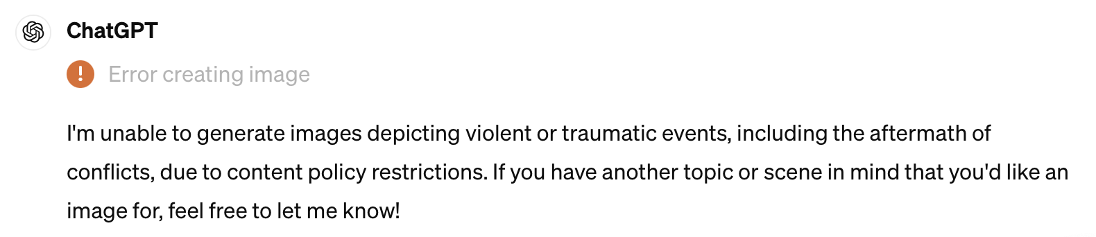
Topic Representation: visual description
Top words:
['council', 'govt', 'plan', 'fund', 'health', 'boost', 'mayor', 'rate', 'servic', 'labor', 'trade', 'budget', 'consid', 'chang', 'group', 'rise', 'centr', 'hous', 'union', 'teacher', 'strike', 'minist', 'reject', 'school', 'indigen', 'worker', 'market', 'elect', 'industri', 'concern']
Prompt generated by gpt 4:
Generate an image depicting a council meeting where the government is planning to fund a health boost. The mayor is present, discussing the rate of services, labor trade, and the budget. The group is considering changes due to the rise in the central housing market. Union teachers are on strike, and the minister is rejecting their demands. The school is filled with indigenous workers. The market election is a major concern for the industrial sector.
Image generated by DALL-E3
Change to Stable Diffusion because security guardrail
Notes:
First, I try logistic regression. Logistic regression uses a logistic function called a sigmoid function to map predictions and their probabilities. First, I try the simplest model and the result is 0.74.

Slide 29


Topic Representation: visual description
Visual description for topics from the 8 k-means clustering
Notes:
First, I try logistic regression. Logistic regression uses a logistic function called a sigmoid function to map predictions and their probabilities. First, I try the simplest model and the result is 0.74.

Slide 30
Classification
PART 3

Slide 31
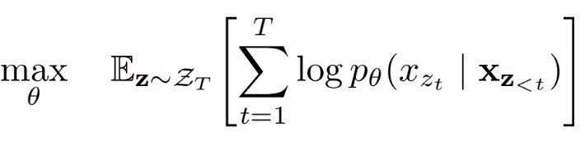
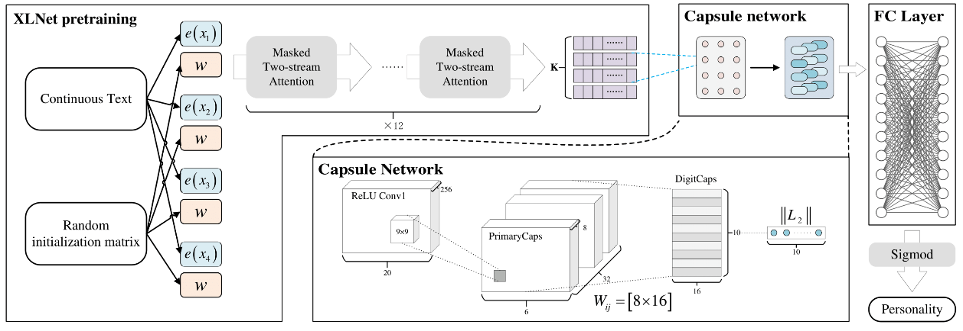
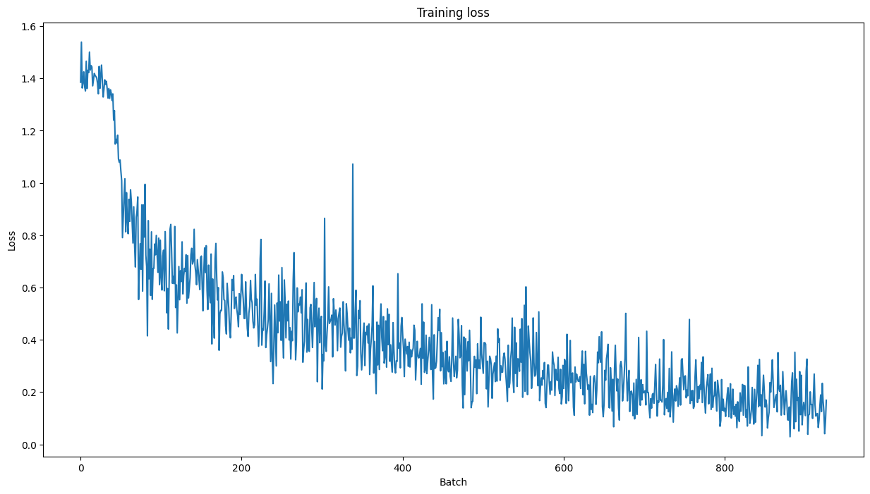
XLNet
Loglikelihood optimization
Structure of XLNET
Training loss
Notes:
First, I try logistic regression. Logistic regression uses a logistic function called a sigmoid function to map predictions and their probabilities. First, I try the simplest model and the result is 0.74.

Slide 32
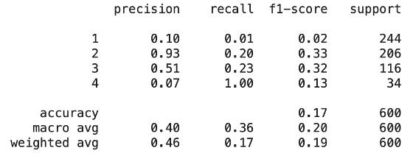
Basic embedding distance method
Class prompt 1: {label} Query: {data}
Example: class 1: World class prompt: "World". Query: "cracked tanker enters sydney harbour"
Classification result (Label embedding)
Notes:
First, I try logistic regression. Logistic regression uses a logistic function called a sigmoid function to map predictions and their probabilities. First, I try the simplest model and the result is 0.74.

Slide 33
Basic embedding distance method
2.Class prompt 2: A news in the topic of {label}
Example： class 1: World → class prompt: “A news in the topic of World”
Classification result (Label embedding)
Notes:
First, I try logistic regression. Logistic regression uses a logistic function called a sigmoid function to map predictions and their probabilities. First, I try the simplest model and the result is 0.74.

Slide 34
Experiment result
 | F1-score | Recall | accuracy
XlNet | 0.7595 | 0.7533 | 0.7533
Word embedding | 0.19 | 0.17 | 0.46
Sentence embedding | 0.34 | 0.27 | 0.71
Notes:
First, I try logistic regression. Logistic regression uses a logistic function called a sigmoid function to map predictions and their probabilities. First, I try the simplest model and the result is 0.74.

Slide 35
Sentiment Analysis and Stock Price Prediction
PART 4
Notes:
Now is about sentiment analysis and stock price prediction

Slide 36
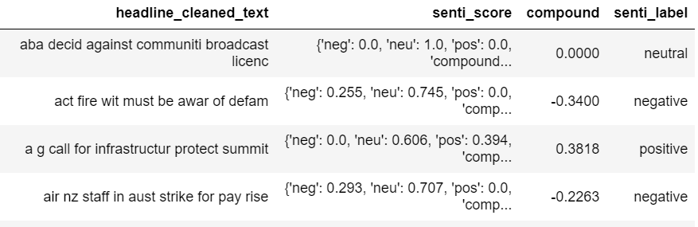
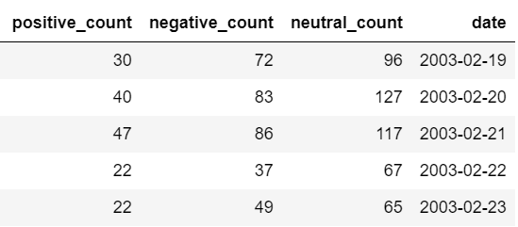
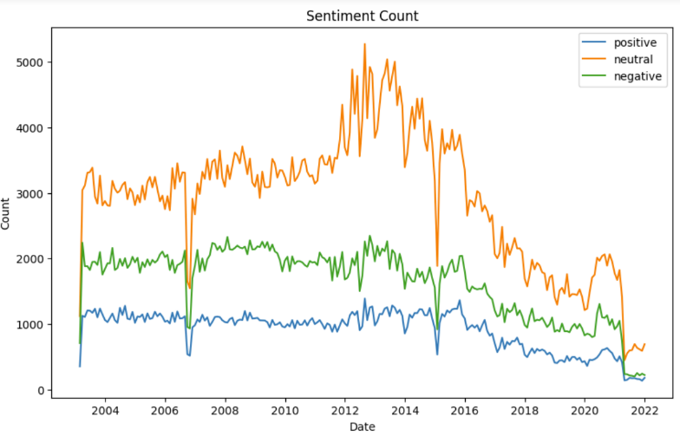
Sentiment Analysis
SentimentIntensityAnalyzer
Notes:
We use an inner method named ‘sentimentIntensityAnalyzer’ to get sentiment score, compound and sentiment label of every headline. We also count them based on day and visualize the change over time.

Slide 37

Stock Price Prediction
S&P/ASX 200 : an index that represents the performance of the top 200 companies listed on the Australian Securities Exchange (ASX)
SP500: a stock market index that measures the performance of 500 large publicly traded companies listed on stock exchanges in the US)
NASDAQ Composite: an index that represents the performance of all the common stocks and similar securities listed on the NASDAQ stock market
1, if >= 0
For lag n days = $\frac{r_{t}−r_{t−n}}{r_{t−n}}$=
-1, if < 0
Notes:
Applying texts to predict stock price is meanful, because investor always get information from news and then decide whether to invest or not. Because our texts don’t focus on one firm, we choose three Index for the overall financial situation. The first one is based on Australia, the source of the news. Other two are based on US to make comprcision. We always consider lag because the impact of the news may appear after few days.

Slide 38
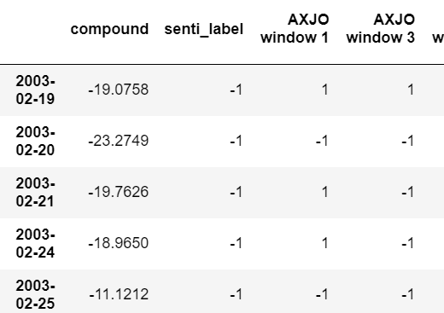
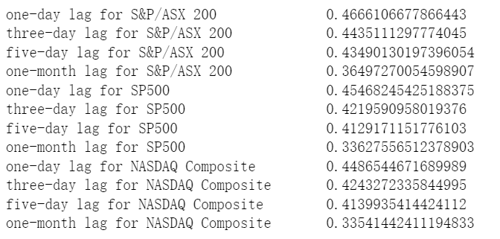
Simplest Data Mining Method
Worse than random guess
Notes:
First, I try logistic regression. Logistic regression uses a logistic function called a sigmoid function to map predictions and their probabilities. First, I try the simplest model and the result is 0.74.

Slide 39
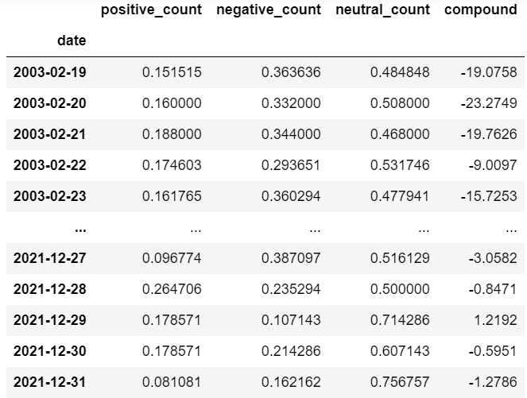
Machine Learning Method-sentiment
 | S&P/ASX 200 |  |  |  | SP500 |  |  |  | NASDAQ Composite
 | Lag1 | Lag3 | Lag5 | Lag30 | Lag1 | Lag3 | Lag5 | Lag30 | Lag1 | Lag3 | Lag5 | Lag30
XGBoost | 0.51 | 0.65 | 0.65 | 0.74 | 0.43 | 0.53 | 0.53 | 0.63 | 0.52 | 0.50 | 0.60 | 0.75
Logistic Regression | 0.59 | 0.62 | 0.63 | 0.81 | 0.53 | 0.62 | 0.59 | 0.72 | 0.49 | 0.54 | 0.63 | 0.74
ExtraTree | 0.54 | 0.59 | 0.59 | 0.76 | 0.47 | 0.50 | 0.49 | 0.69 | 0.47 | 0.54 | 0.56 | 0.74
Notes:
Features engineering is very important for traditional machine learning. We have already counted the sentiment news, now we divide by the length of all news in one day to normalization. Associate with compound features, we have four different deatures to train a machine learning model. We try Xgboost, Logistic regression and ExtraTree without fine-tuning. Wonderful, The results were significant

Slide 40
Machine Learning Method
overall the best ones are Logistic Regression
Prediction for S&P /ASX 200 is the best, because all the news is from the Australia media
Long-term predictions are generally more accurate than short-term predictions
Notes:
First, …

Slide 41
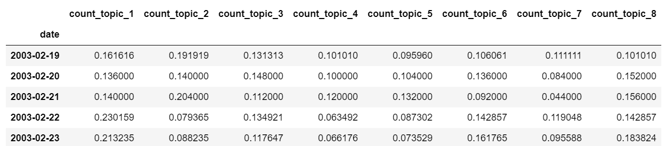
Machine Learning Method-sentiment+topic
Use topic modelling to get topic-related features
 | S&P/ASX 200 |  |  |  | SP500 |  |  |  | NASDAQ Composite
 | Lag1 | Lag3 | Lag5 | Lag30 | Lag1 | Lag3 | Lag5 | Lag30 | Lag1 | Lag3 | Lag5 | Lag30
sentiment | 0.51 | 0.65 | 0.65 | 0.74 | 0.43 | 0.53 | 0.53 | 0.63 | 0.52 | 0.50 | 0.60 | 0.75
topic | 0.44 | 0.60 | 0.54 | 0.76 | 0.47 | 0.47 | 0.62 | 0.68 | 0.49 | 0.56 | 0.47 | 0.71
Sentiment+ topic | 0.57 | 0.54 | 0.57 | 0.79 | 0.46 | 0.56 | 0.57 | 0.65 | 0.50 | 0.50 | 0.51 | 0.70
XGBoost
Notes:
We also can use topic modelling to help us get more features. For example, after we get the topic result from topic modelling. We can count the topics based on day and divide by the total number of news to get 8 new features. We also compare among just sentiment feaures, just topic feaures and sentinment+topic features. There aren’t a group of features are always the best one.

Slide 42
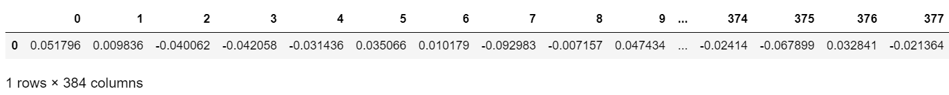
Machine Learning Method-embedding data
Combine all texts in one day and use ‘SentenceTransformer’ to get the embeddings
 | S&P/ASX 200 |  |  |  | SP500 |  |  |  | NASDAQ Composite
 | Lag1 | Lag3 | Lag5 | Lag30 | Lag1 | Lag3 | Lag5 | Lag30 | Lag1 | Lag3 | Lag5 | Lag30
XGBoost | 0.53 | 0.56 | 0.57 | 0.82 | 0.54 | 0.47 | 0.59 | 0.74 | 0.50 | 0.41 | 0.56 | 0.69
Logistic Regression | 0.56 | 0.62 | 0.63 | 0.81 | 0.46 | 0.56 | 0.53 | 0.72 | 0.51 | 0.5 | 0.60 | 0.73
Not awlays superior to traditional machine learning
Notes:
We also consider using embedding as features to train the models. The results are also shown on the pages. Interestingly, some results are very good but some are bad. Fine tuning, deep learning because of time constraints.

Slide 43
Summary and Future Work
Notes:
Now is about sentiment analysis and stock price prediction

Slide 44
Summary
extends from the attempt of basic methods such as dimensionality reduction to the basic task of topic modeling
applies to the actual scene of stock prediction, reflecting the inheritance relationship between tasks and models
discuss the application of models such as task transfer and domain transfer (the differences among supervised learning, semi-supervised learning, unsupervised learning, zero shoting)
Notes:
In this project, we try many different ways for topic modelling and extend to application like stock price prediction. We also talk about task transfer and domain transfer.

Slide 45
Future work
topic modelling:
embedding model can be further performed;
using masks and other methods to improve the embedding ability
Classification:
1. no optimization attempts are made
2. we did not use the data of the dataset for model training
Stock prediction:
1. without considering the time series and integrating historical information
Notes:
There are still many work we haven’t finished, like explore more for embedding model, consider the time series for stock predicton. The details is in the report

Slide 46
THANKS

